Slide 1
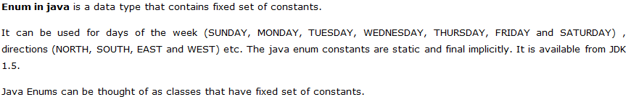
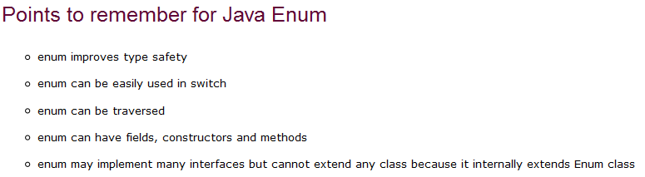
Enums

Slide 2
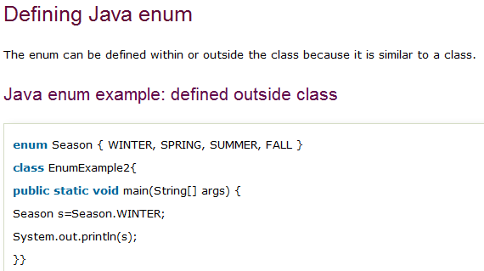
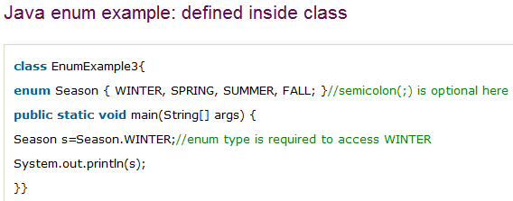

Slide 3
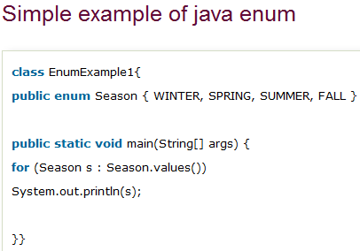



Slide 4
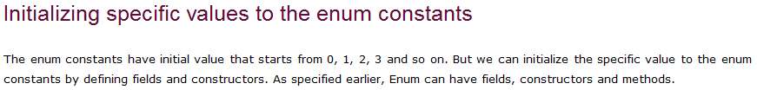
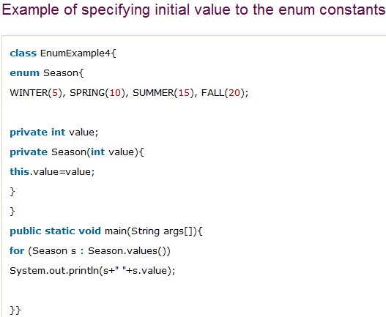


Slide 5

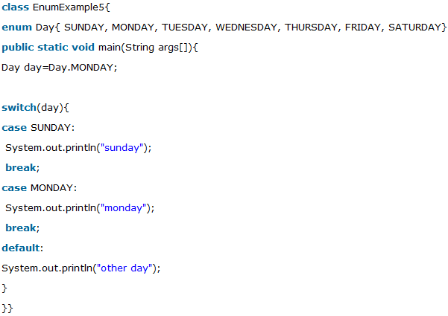

Slide 6
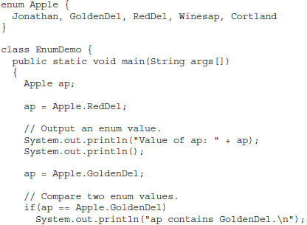
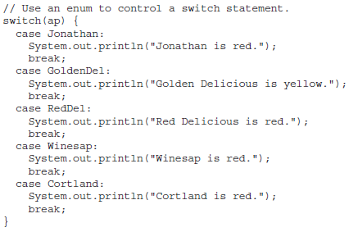
Example 1

Slide 7
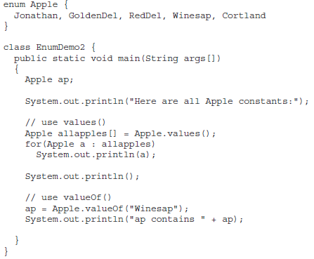
Example 2 (values( ) and valueOf( ) Methods)
The values( ) method returns an array that contains a list of the enumeration constants.
The valueOf( ) method returns the enumeration constant whose value corresponds to the string passed.

Slide 8
Exercise
Write a program to create enum of food-items having specific price-value for each.
Now take the order from the customer where he will be asked to enter the name of the food-item he wants to order.
Use the switch statement to display the price of item ordered.

Slide 9
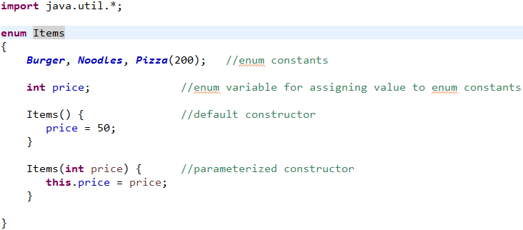
Solution

Slide 10
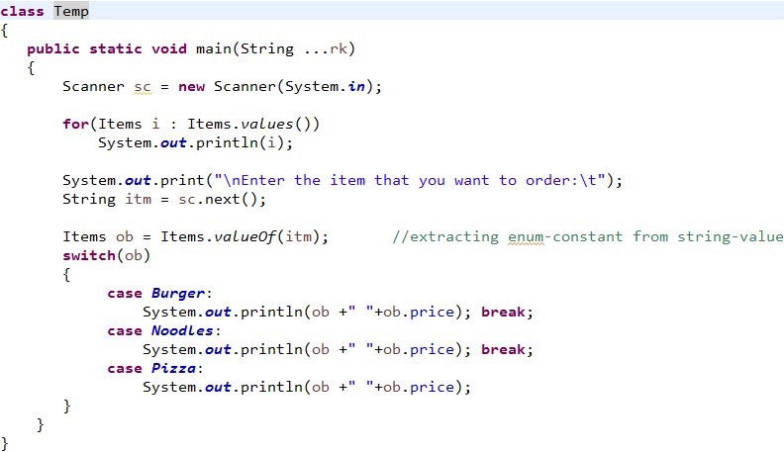

Slide 11
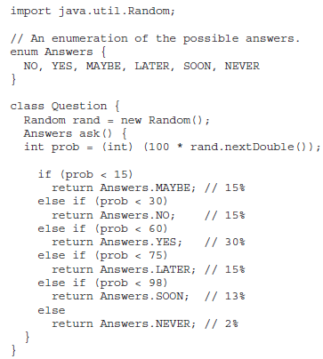
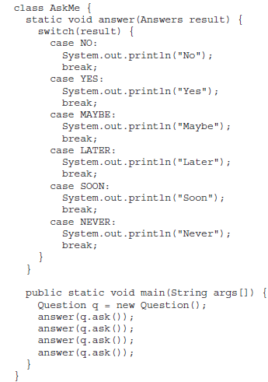
Example 3 (Automated decision maker)

Slide 12
Date-time

Slide 13
Working with Local Date and Time
java.time API provides two classes for working with local Date and Time.
LocalDate
  Does not include time
  A year-month-day representation
  toString – ISO 8601 format(YYYY-MM-DD)
LocalTime
  Does not include date
  Stores hours:minutes:seconds.nanoseconds
  toString- (HH:mm:ss.SSSSSSSSS)

Slide 14
Printing LocalDate, LocalTime and LocalDateTime
LocalDate date = LocalDate.now();
LocalTime time = LocalTime.now();
LocalDateTime dt = LocalDateTime.now();

Slide 15
LocalDate class

Slide 16
Methods of LocalDate
public static LocalDate now()
public static LocalDate now(ZoneId zone)
public static LocalDate of(int year, Month month, int dayOfMonth)
public static LocalDate of(int year, int month, int dayOfMonth)
Note: DateTimeException can be thrown.
public static LocalDate parse(CharSequence text)
Note: DateTimeParseException can be thrown.

Slide 17
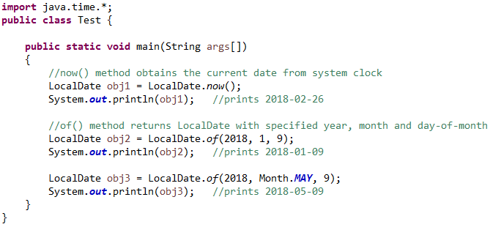
LocalDate
Java LocalDate class is an immutable class that represents Date with a default format of YYYY-MM-DD

Slide 18
Key points
A runtime exception is thrown if invalid values are used:
  Valid range for month parameter → 1 to 12
  Valid range for day parameter → 1 to 31 (depending upon the month)

Slide 19
Methods of LocalDate
Methods
public int getYear()
public int getMonthValue()
public Month getMonth()
public int getDayOfMonth()
public int getDayOfYear()
public DayOfWeek getDayOfWeek()
public boolean isLeapYear()

Slide 20
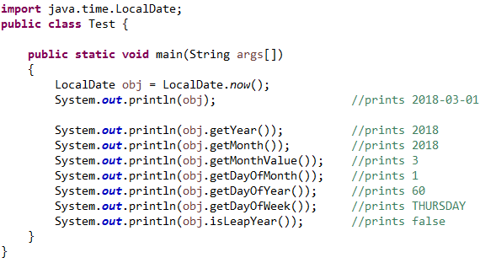
Example

Slide 21
Methods of LocalDate
public LocalDate plusYears(long yearsToAdd)
public LocalDate plusMonths(long monthsToAdd)
public LocalDate plusWeeks(long weeksToAdd)
public LocalDate plusDays(long daysToAdd)
public LocalDate minusYears(long yearsToSubtract)
public LocalDate minusMonths(long monthsToSubtract)
public LocalDate minusWeeks(long weeksToSubtract)
public LocalDate minusDays(long daysToSubtract)

Slide 22
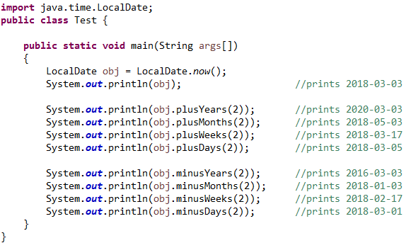
Example

Slide 23
Exercise 1
WAP to perform following activities on the date enter by user in format : YYYY-MM-DD
Is it in future or past?
Is it in a leap year?
What day of the week is it?
What is the day a month from now?

Slide 24
Exercise 2
WAP which prompts the user to enter a Date using command-line argument and the number of year, months and days.
Now find out what is the Day after “n” no. of days, years and months from the entered Date.

Slide 25
Exercise 3
Write an application that computes and displays the day on which you become (or became) 10,000 days old. Save the application as TenThousandDaysOld.java.

Slide 26
Exercise 4
Write a program that declares two LocalDate objects and assign values that represent January 31 and December 31 in the current year. Display output that demonstrates the dates displayed when one, two, and three months are added to each of the objects. Save the application as TestMonthHandling.java.

Slide 27
Exercise 5
Write a program to display dates of all Sundays of current year from now on.

Slide 28
LocalTime class

Slide 29
LocalTime class
A time without a time-zone in the ISO-8601 calendar system, such as 10:15:30. 13
LocalTime is an immutable date-time object that represents a time, often viewed as hour-minute-second.
Time is represented to nanosecond precision.
For example, the value "13:45:30.123" can be stored in a LocalTime.
This class does not store or represent a date or time-zone.

Slide 30
Methods of LocalTime
Methods
public static LocalTime now()
public static LocalTime now(ZoneId zone)
public static LocalTime of(int hour, int minute)
public static LocalTime of(int hour, int minute, int second)
public static LocalTime of(int hour, int min, int sec, int nsec)
public static LocalTime parse(CharSequence text)

Slide 31
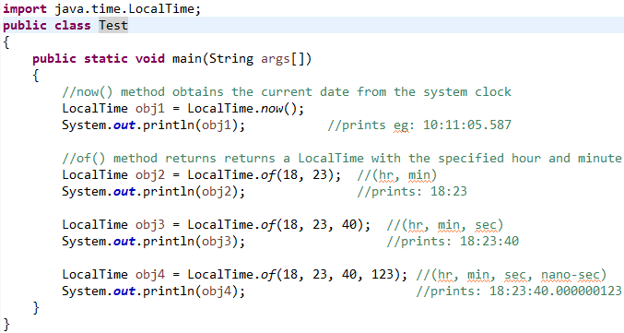
LocalTime
Java LocalTime class is an immutable class that represents time with a default format of hour-minute-second

Slide 32

Key points
Valid range for hour parameter → 0 to 23
Valid range for minutes parameter → 0 to 59
Valid range for seconds parameter → 0 to 59
Valid range for nono-seconds parameter → 0 to 999,999,999

Slide 33
Methods of LocalTime
Methods
public int getHour()
public int getMinute()
public int getSecond()
public int getNano()
public boolean isAfter(LocalTime l)
public boolean isBefore(LocalTime l)

Slide 34
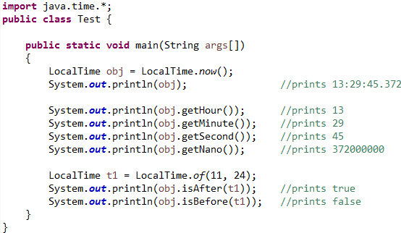
Example

Slide 35
Methods of LocalTime
Methods
public LocalTime plusHours(long hours)
public LocalTime plusMinutes(long min)
public LocalTime plusSeconds(long sec)
public LocalTime plusNanos(long ns)
public LocalTime minusHours(long hours)
public LocalTime minusMinutes(long min)
public LocalTime minusSeconds(long sec)
public LocalTime minusNanos(long ns)

Slide 36
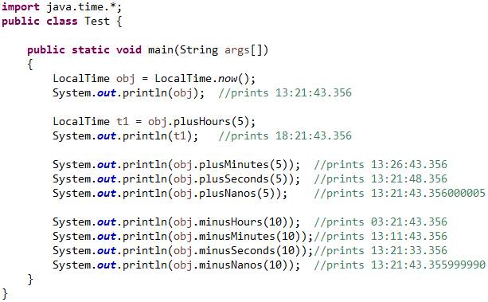
Example

Slide 37
Exercise
WAP to perform following activities on the Time enter by user in format: HH:MM:SS
When is my lunch time?
Is lunch time in the future or past?
What is the time 1 hour 15 minutes from now?
How many minutes until lunch time?
How many hours until bedtime?
Train departs Delhi at 1:45PM and arrives Prayagraj at 7:25PM
How many minutes long is the train ride?
If the train was delayed 1 hour 19 minutes, what is the actual arrival time?

Slide 38
LocalDateTime class

Slide 39
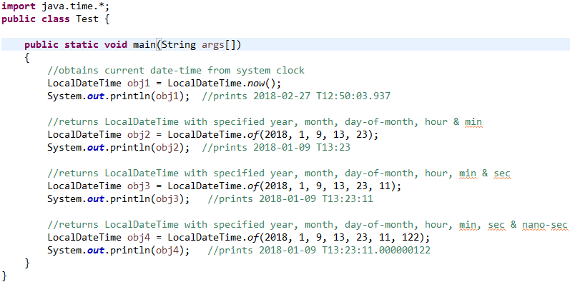
LocalDateTime
Java LocalDateTime class is an immutable date-time object that represents a date-time, with the default format as YYYY-MM-DD-HH-mm-ss.zzz

Slide 40
Methods of LocalDateTime
Methods
public int getHour()
public int getMinute()
public int getSecond()
All other getter methods of LocalDate and LocalTime class
public LocalDateTime plusHours(long hours)
public LocalDateTime plusMinutes(long min)
public LocalDateTime minusHours(long hours)
All the plus and minus methods of LocalDate and LocalTime class

Slide 41
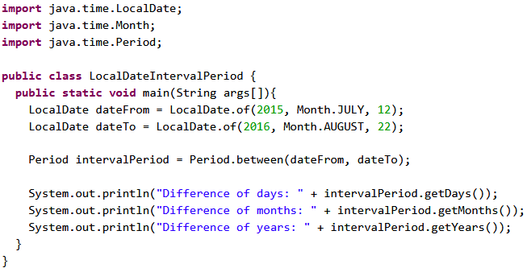
Calculate difference between two dates

Slide 42
Exercise
A company XYZ have fixed the meeting with company ABC on 15th December 2016 at 14:00 o’clock. WAP to answer following queries:
  When is the meeting with corporate?
  When does my flight leave?
  If I move the meeting to Friday, What is the date?
A training institute is going to start its new batch for Android training for 15 days on 25th November 2016. WAP to answer following queries:
  When does the course start?
  If the course start at 9 AM on Monday and ends at 5 PM on Friday, how many hours am I in class.

Slide 43
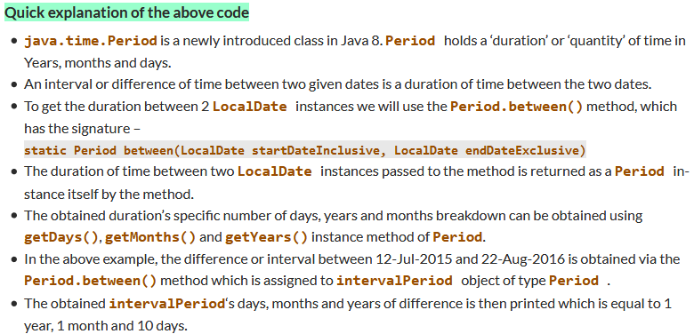

Slide 44
Singleton class

Slide 45
Singleton class
The purpose of Singleton is to control object creation, limiting the number of objects to only one.
Since there is only one Singleton instance (object), any instance fields (variables) of a Singleton will occur only once per class, just like static fields.
Singletons often control access to resources, such as database connections or sockets.
  For example, if you have a license for only one connection for your database or your JDBC driver has trouble with multithreading, the Singleton makes sure that only one connection is made or that only one thread can access the connection at a time.

Slide 46
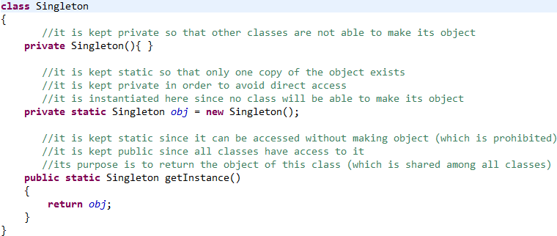
Example 1

Slide 47
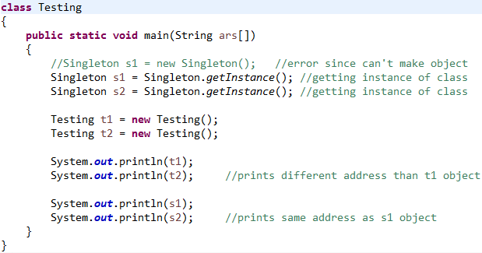

Slide 48
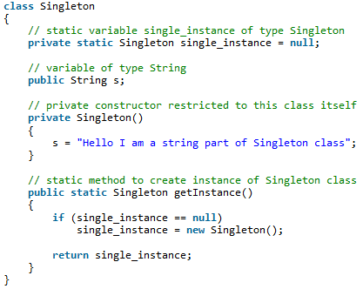
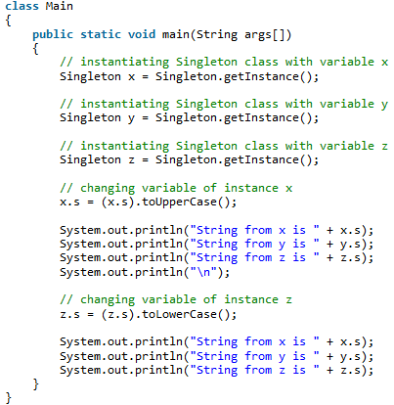
Example 2
If we change the variables of object x, that is reflected when we access the variables of objects y and z.
Also if we change the variables of object z, that is reflected when we access the variables of objects x and y.

Slide 49
Creating Immutable class

Slide 50
Steps to create immutable class
Following are the requirements:
• Class must be declared as final (So that child classes can’t be created, since they can create similar attributes and can provide setter methods and can override existing getter methods, hence defeating the purpose)
• Data members in the class must be declared as final (So that we can’t change the value of it after object creation)
• A parameterized constructor (to initialize final variables)
• Getter method for all the variables in it (to access the variables if they are declared private).
• No setters(To not have option to change the value of the instance variables)

Slide 51
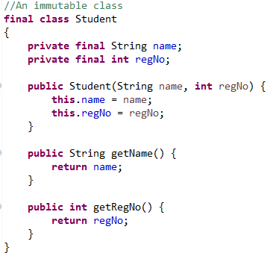
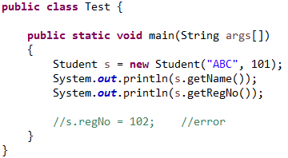
Example

